Slide 1
Aerial Object Detection
HyeongJun Kwon
2019-2

Slide 2
Contents
1. EAST: An Efficient and Accurate Scene Text Detector
2. Towards Multi-class Object Detection in Unconstrained Remote Sensing Imagery

Slide 3
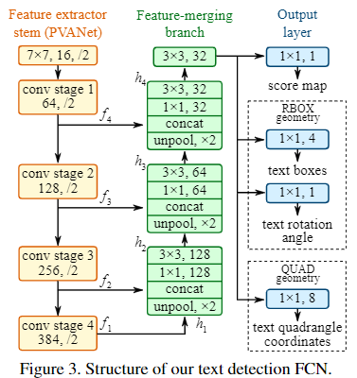
EAST: An Efficient and Accurate Scene Text Detector
Network Overview
Pipeline
Input image
Multi-channel
FCN
Multi-channel
FCN
Multi-oriented
Task-wise boxes

Slide 4
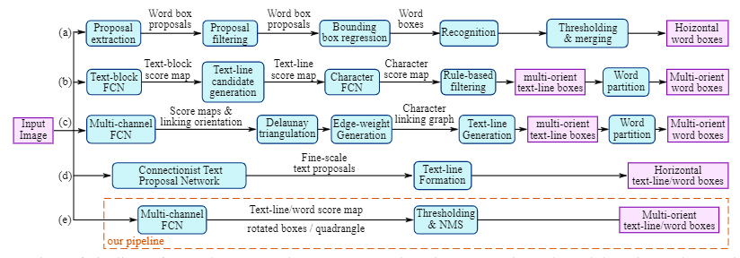
EAST: An Efficient and Accurate Scene Text Detector
Main Contributions :
1. propose two stage(step) method : FCN and NMS merging stage
2. pipeline is flexible

Slide 5
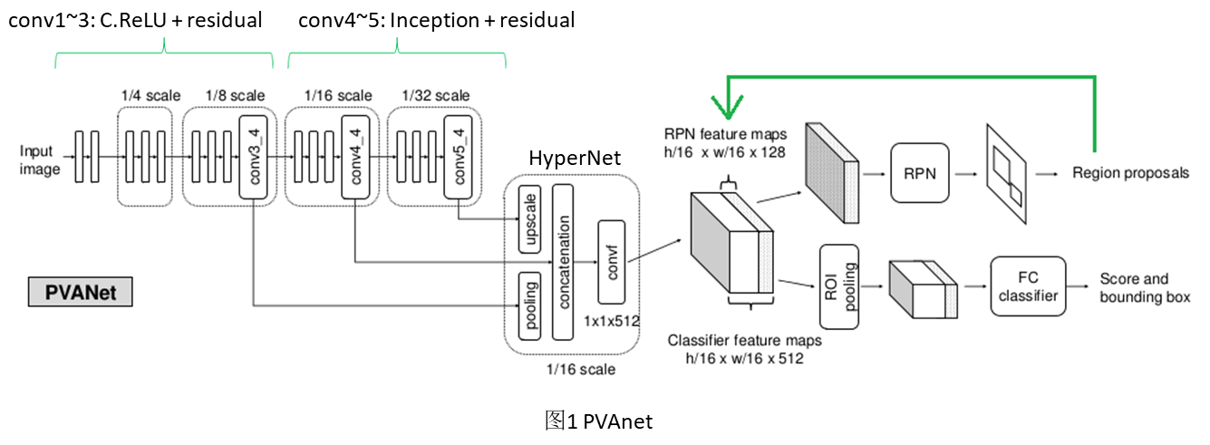
EAST: An Efficient and Accurate Scene Text Detector
Relate work: PVANet

Slide 6
EAST: An Efficient and Accurate Scene Text Detector
Pipeline
input
output
For reduce computation cost, using U-shape not using HyperNet in PVANet that merge all feature maps
conv1
merging3
conv2
merging2
conv3
merging1
conv3

Slide 7
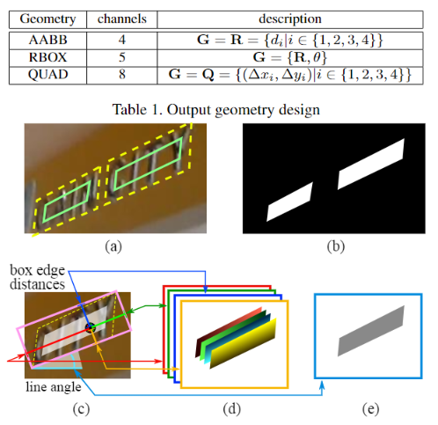
EAST: An Efficient and Accurate Scene Text Detector
Label Generation

Slide 8
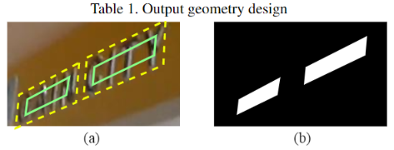


EAST: An Efficient and Accurate Scene Text Detector
Label Generation: Score Map Generation
Score map generation eq
$$r_{i}=min(D\left(p_{i}, p_{\left(i mod 4\right)+1}\right),$$
$$D\left(p_{i}, p_{\left(\left(i+2\right) mod 4\right)+1}\right)$$
we shrink it by moving its two endpoints inward along the edge by$0.3r_{i} and 0.3r_{\left(i mod 4\right)+1}$espectively.

Slide 9

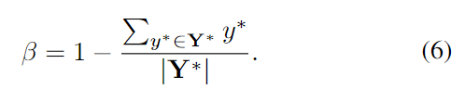

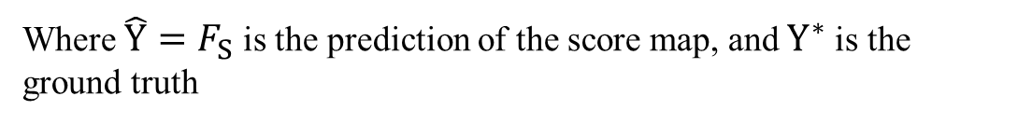
EAST: An Efficient and Accurate Scene Text Detector
Label Generation: Loss
$$L=L_{s}+λ_{g}L_{g}$$
$L_{s}$ : loss for score map
$L_{g}$ : loss for geometry
Where $\hat{Y}=F_{S}$ is the prediction of the score map, and $Y^{∗}$is the ground truth

Slide 10


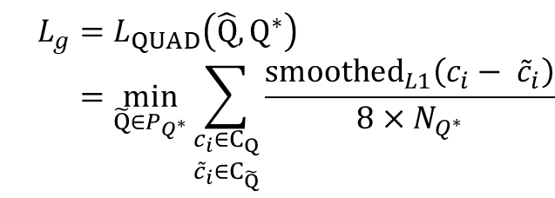
EAST: An Efficient and Accurate Scene Text Detector
Label Generation: Loss
$$L=L_{s}+λ_{g}L_{g}$$
$L_{s}$ : loss for score map
$L_{g}$ : loss for geometry
RBOX: $L_{g}=L_{AABB}+λ_{θ}L_{θ}$
QUAD:
$$L_{g}=L_{QUAD}\left(\hat{Q}, Q^{∗}\right) \\ =\min_{\tilde{Q}∈P_{Q^{∗}}}{\sum_{\begin{aligned}c_{i}∈C_{Q} \\ {\tilde{c}}_{i}∈C_{\tilde{Q}}\end{aligned}}{\frac{{smoothed}_{L1}\left(c_{i}− {\tilde{c}}_{i}\right)}{8×N_{Q^{∗}}}}}$$

Slide 11
EAST: An Efficient and Accurate Scene Text Detector
Locality-Aware NMS
Problem: A naïve NMS algorithm runs in $O\left(n^{2}\right)$where $n$ is the number of candidate geometries.
The geometries from nearby pixels tend to be highly correlated.
Solution: locality-aware NMS
$$a=WEIGHTEDMERGE\left(g,p\right), then a_{i}=V\left(g\right)g_{i}+V\left(p\right)p_{i} and V\left(a\right)=V\left(g\right)+V(p)$$

Slide 12
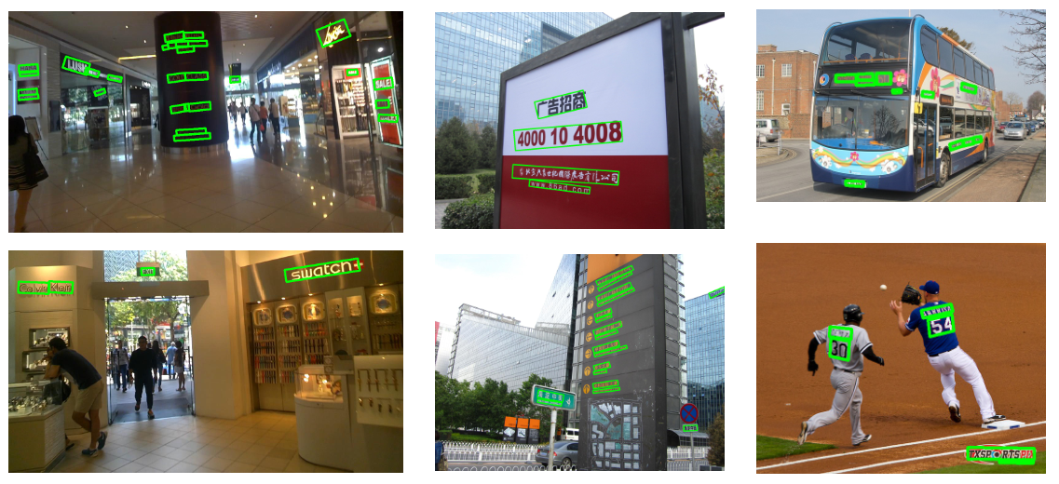
EAST: An Efficient and Accurate Scene Text Detector

Slide 13
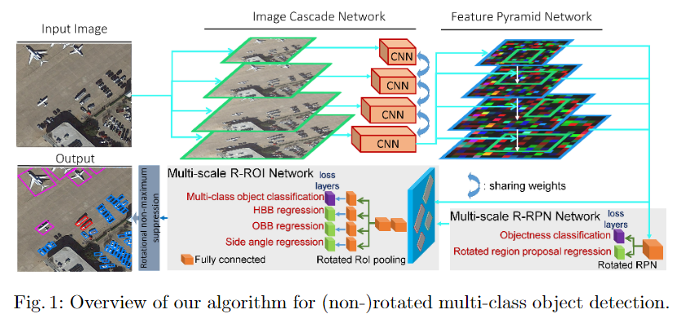
Towards Multi-class Object Detection in Unconstrained Remote Sensing Imagery
Network Overview

Slide 14
Towards Multi-class Object Detection in Unconstrained Remote Sensing Imagery
Main Contributions :
1. new joint image cascade and feature pyramid network(ICN and FPN)
2. design a DIN module as a domain adaptation module
3. new loss function to shape rectangles by constraining the angles between the edges to 90 degrees

Slide 15
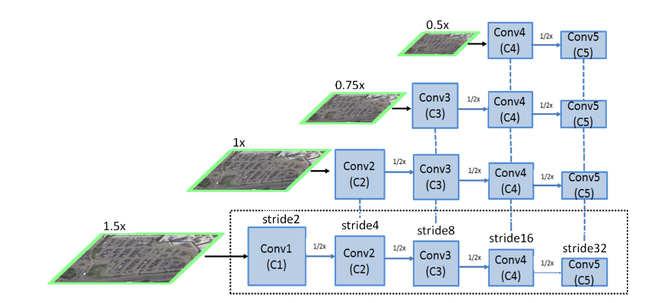
Towards Multi-class Object Detection in Unconstrained Remote Sensing Imagery
ICN, FPN and Deformable Inception Subnetworks
Appropriate weights sharing
Resize image size by bilinear interpolation
ICN
The low-level semantic feature from high resolution
The high-level semantic feature from low-level resolution

Slide 16
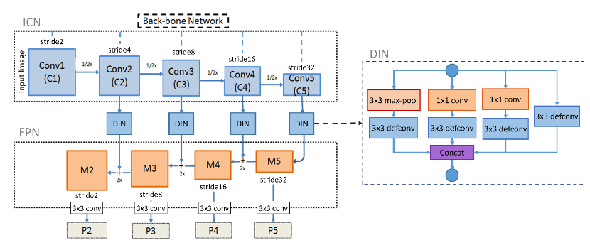
Towards Multi-class Object Detection in Unconstrained Remote Sensing Imagery
ICN, FPN and Deformable Inception Subnetworks
Notes:
DIN 내부에 deformable convolution을 통해 geometric transformation을 적용하는 것을 도와주고 더욱 offset regression property는 kernel 외부의 object를 localization하는 것을 도움 줍니다.

Slide 17



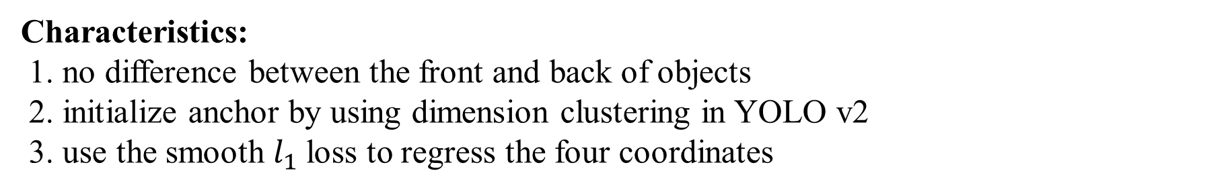
Towards Multi-class Object Detection in Unconstrained Remote Sensing Imagery
R-RPN
Characteristics:
1. no difference between the front and back of objects
2. initialize anchor by using dimension clustering in YOLO v2
3. use the smooth $l_{1}$loss to regress the four coordinates
Notes:
DIN 내부에 deformable convolution을 통해 geometric transformation을 적용하는 것을 도와주고 더욱 offset regression property는 kernel 외부의 object를 localization하는 것을 도움 줍니다.

Slide 18
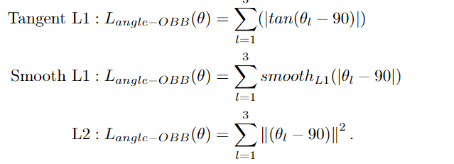
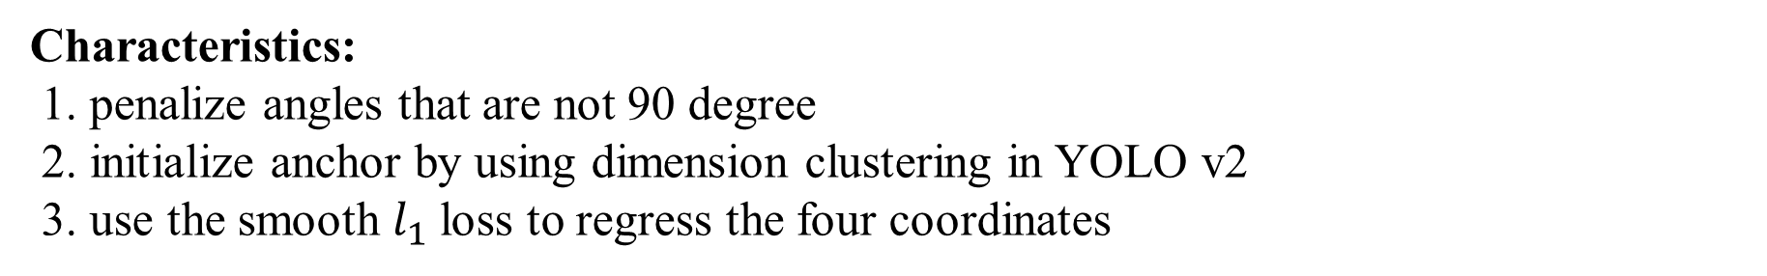
Towards Multi-class Object Detection in Unconstrained Remote Sensing Imagery
R-ROI
Characteristics:
1. penalize angles that are not 90 degree
2. initialize anchor by using dimension clustering in YOLO v2
3. use the smooth $l_{1}$loss to regress the four coordinates
penalize angles that are not 90 degree
Notes:
DIN 내부에 deformable convolution을 통해 geometric transformation을 적용하는 것을 도와주고 더욱 offset regression property는 kernel 외부의 object를 localization하는 것을 도움 줍니다.

Slide 19

Towards Multi-class Object Detection in Unconstrained Remote Sensing Imagery
Objective
Notes:
DIN 내부에 deformable convolution을 통해 geometric transformation을 적용하는 것을 도와주고 더욱 offset regression property는 kernel 외부의 object를 localization하는 것을 도움 줍니다.

Slide 20
Towards Multi-class Object Detection in Unconstrained Remote Sensing Imagery
Objective
Notes:
DIN 내부에 deformable convolution을 통해 geometric transformation을 적용하는 것을 도와주고 더욱 offset regression property는 kernel 외부의 object를 localization하는 것을 도움 줍니다.

Slide 21
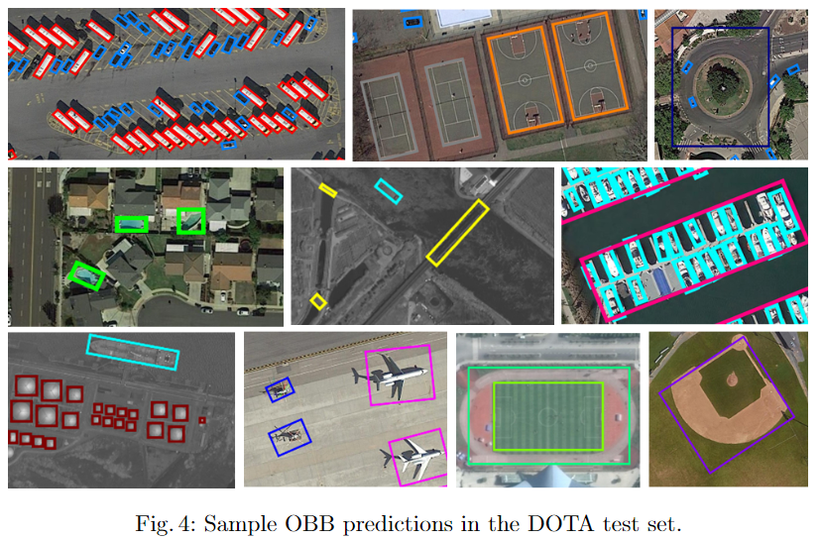
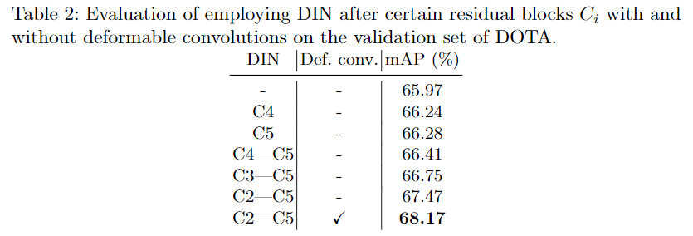
Towards Multi-class Object Detection in Unconstrained Remote Sensing Imagery
Result
Notes:
DIN 내부에 deformable convolution을 통해 geometric transformation을 적용하는 것을 도와주고 더욱 offset regression property는 kernel 외부의 object를 localization하는 것을 도움 줍니다.

Slide 22
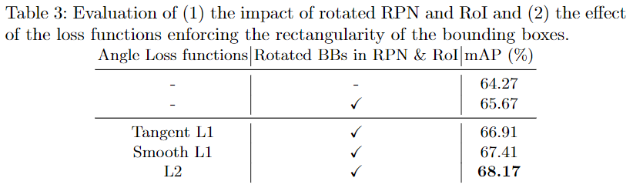
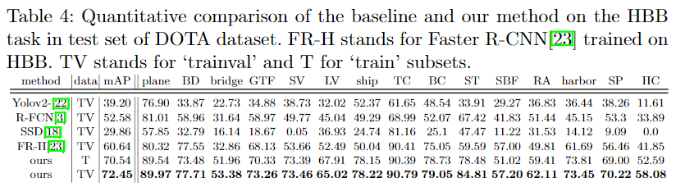
Towards Multi-class Object Detection in Unconstrained Remote Sensing Imagery
Result
Notes:
DIN 내부에 deformable convolution을 통해 geometric transformation을 적용하는 것을 도와주고 더욱 offset regression property는 kernel 외부의 object를 localization하는 것을 도움 줍니다.

Slide 23
Towards Multi-class Object Detection in Unconstrained Remote Sensing Imagery
Result
Notes:
DIN 내부에 deformable convolution을 통해 geometric transformation을 적용하는 것을 도와주고 더욱 offset regression property는 kernel 외부의 object를 localization하는 것을 도움 줍니다.

Slide 24
Reference
EAST:
PVANET: Deep but lightweight neural networks for real-time object detection.
Balanced-cross entropy:
Holistically-nested edge detection
Scene text detection via holistic, multi-channel prediction.
U-shape: U-net: Convolu-tional networks for biomedical image segmentation.
Towards Multi-class Object Detection in Unconstrained Remote Sensing Imagery:
Soft-NMS: Improving object detection with one line of code.
IoU distance: Yolo9000: Better, faster, stronger.
DIN: deformable convolutional networks
Notes:
DIN 내부에 deformable convolution을 통해 geometric transformation을 적용하는 것을 도와주고 더욱 offset regression property는 kernel 외부의 object를 localization하는 것을 도움 줍니다.

